Slide 1
How can restorative justice strengthen society and restore justice?
Tim Chapman
Ulster University
European Forum for Restorative Justice

Slide 2
In 1999, the Council of Europe adopted Recommendation No. R (99) 19 of the Committee of Ministers to member States concerning Mediation in Penal Matters
Notes:
The Council of Europe were advised by a group of academics and experienced practitioners. As a direct result of this collaboration the European Forum for Restorative Justice was established.

Slide 3
In October 2018, the Council of Europe adopted the Recommendation of the Committee of Ministers to member States concerning Restorative Justice in criminal matters

Slide 4
2018 Recommendation
This Recommendation aims to encourage member States to develop and use restorative justice with respect to their criminal justice systems.
It promotes standards for the use of restorative justice in the context of the criminal procedure, and seeks to safeguard participants’ rights and maximise the effectiveness of the process in meeting participants’ needs.
It also aims to encourage the development of innovative restorative approaches ‑ which may fall outside of the criminal procedure ‑ by judicial authorities, and by criminal justice and restorative justice agencies.

Slide 5
Definition
‘Restorative justice’ refers to any process which enables those harmed by crime, and those responsible for that harm, if they freely consent, to participate actively in the resolution of matters arising from the offence, through the help of a trained and impartial third party (hereinafter: the ‘facilitator’).
‘Restorative justice’ refers to any process which enables those harmed by crime, and those responsible for that harm, if they freely consent, to participate actively in the resolution of matters arising from the offence, through the help of a trained and impartial third party (hereinafter: the ‘facilitator’).

Slide 6
Why the change?
The 1999 Recommendation was not fully implemented
Research into restorative justice has found generally positive results and has a growing influence
Due to the increasing focus on victims’ rights and needs a focus on harm rather than conflict.
The 2018 Recommendation refers to the participants in restorative justice as ‘those harmed by crime, and those responsible for that harm’, rather than simply as the ‘victim and offender’. This reflects the fact that crime can have a significant impact on the community (whether defined geographically or socially) and on other parties beyond the direct victim. Under certain conditions, the involvement of relevant professionals (such as police officers, teachers or social workers), supporters of the parties (such as their friends and family) and representatives of affected communities, can play a significant role in the restorative justice process.
The role is defined as facilitator rather than mediator.
A more flexible process available at any stage of the criminal justice process and applicable to the full range of crimes.
A wider range of processes: restorative justice may include victim‑offender mediation, penal mediation, restorative conferencing, family group conferencing, sentencing circles or peacemaking circles, etc.
Notes:
Harm v Conflict.

Slide 7
The importance of values and quality
There is now considerable evidence that institutional needs regularly over-ride the needs of the people that the institution is designed to serve (Pavlich 2009, Hoyle and Rosenblatt 2016, Bolivar 2015, Choi et al 2013, Zernova 2007, Choi and Gilbert 2010, Hoyle et al 2002, Strang 2002, Barnes 2016, Bolivar, Pelikan and Lemonne 2015)
The key blind spot is the quality of engagement of victims and the quality of their active participation in face to face meetings.
Notes:
This represents a challenge even to restorative practitioners. Most practitioners come from another professional background They are attracted to RJ because it is an improvement e.g. me, Terry, Ted. Consequently it is easy to drift back to serving institutional aims and needs rather than enabling people to attend to their own needs and wishes.

Slide 8
European Forum for Restorative Justice
Increase access to and the use of restorative justice in all its forms
Increase the quality of practice
Increase the contexts in which it takes place
Inform the public
Influence policy
Develop the quality of practice and research

Slide 9
Connecting people to restore just relations
Restorative justice is an approach to addressing harm or the risk of harm through engaging all those affected in coming to a common understanding and agreement on how the harm or wrongdoing can be repaired and justice achieved.
Restorative justice is relevant to and effective in the contexts of justice, security, peacebuilding, education, social development, family support, children’s rights and well being, as well as organisational and community life.

Slide 10
Values
Respect for human dignity
Solidarity and responsibility
Justice
Truth

Slide 11
Principles
Voluntary participation based on informed consent
Direct and authentic communication
Processes designed to fit the participants' needs, capabilities and culture
Value each participant's needs and wishes equally
Non-judgmental, multi-partial facilitation
The importance of dialogue
Rigorous implementation of agreed actions

Slide 12
Is as it should be
Values
Principles
Standards
Research

Slide 13
Respect for human dignity
Solidarity and responsibility
Justice
Truth
Populism
Globalisation
Inequality
Nationalism
Ghettos
Fundamentalism
Securitisation
Walls
Fake news
Corruption
Violence

Slide 14
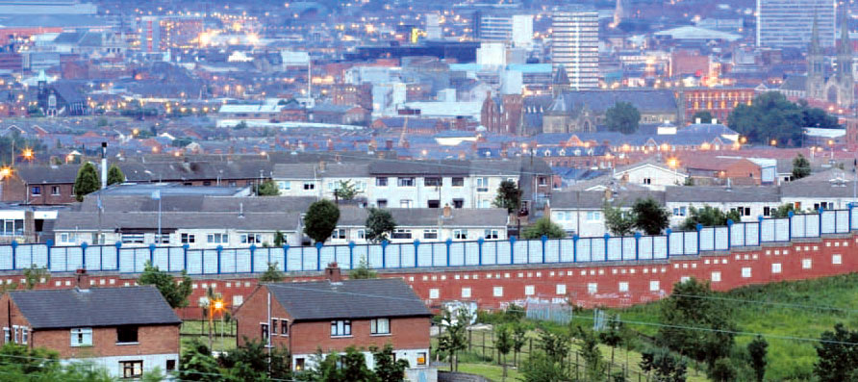

Slide 15
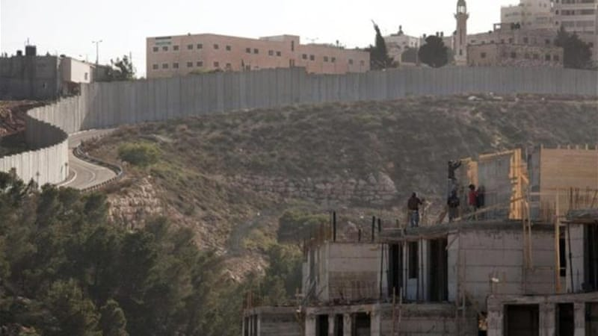

Slide 16
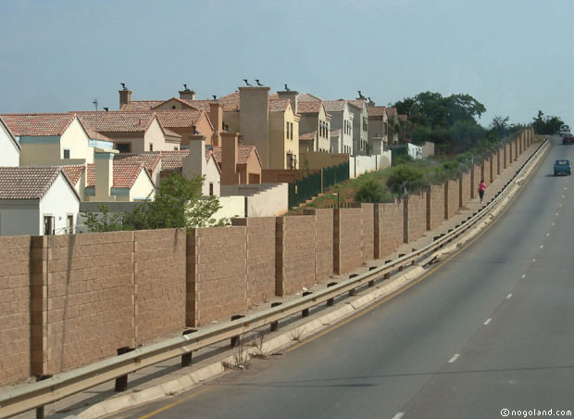

Slide 17
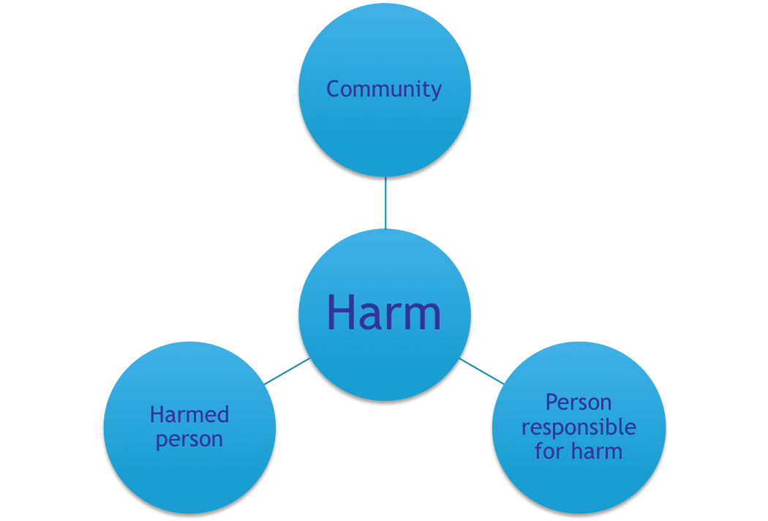
Connections and relationships
The most important relationship may not be between
the key parties. But their connection is critical.

Slide 18


ALTERNATIVE:
Developing alternative understandings of security and justice through restorative justice approaches in intercultural contexts within democratic societies
A partnership between Austria, Belgium, Hungary, Northern Ireland, Norway and Serbia
This presentation reflects only the presenter’s views and that the Union is not liable for any use that may be made of the information contained therein.

Slide 19
Partners
KU Leuven, Belgium
European Forum for Restorative Justice
Nova Research Institute, Norway
Institute for the Sociology of Law and Criminology (IRKS), Austria
Foresee Research Group, Hungary
The Victimology Society of Serbia (VDS)
Ulster University (UU), Northern Ireland

Slide 20
1.How can the application of restorative justice offer a meaningful intervention at a distance from the criminal justice system and what does this expansion mean for the discourse of restorative justice?
2.How can a restorative justice discourse offer an alternative to the current security discourses, especially in intercultural contexts?

Slide 21
Northern Ireland
Contribute through researching of RJ concepts and practices in assisting Northern Ireland to move from being a conflicted society to an agreed society after 30 years of violent civil conflict;
To provide alternative understandings of conflict and its resolution and to develop and design appropriate RJ strategies and interventions that strengthen social inclusion, active citizenship and social cohesion in a variety of social contexts;
To evaluate the effectiveness of training community activists, political prisoners and ex-combatants in RJ and non-violent methods of resolving conflict;
Conducting an action research programme focusing on restorative responses in three sites in order to adequately address conflicts.

Slide 22

Books: Routledge (2018)
Restoring Justice and Security in Intercultural Europe (Ivo Aertsen and Brunilda Pali, eds. ) – on the theoretical aspects of the project
Action Research in Criminal Justice: Restorative justice approaches in intercultural settings (Inge Vanfraechem and Ivo Aertsen, eds.) – on the action research

Slide 23
Website http://alternativeproject.eu contact tj.chapman@ulster.ac.uk thank you

