Slide 1
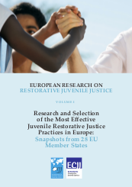
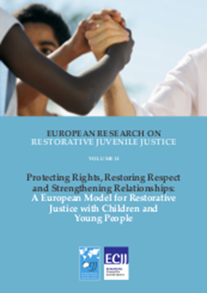
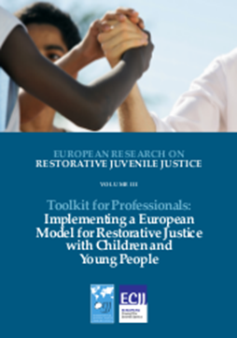
European Model for Restorative Justice with Children and Young People http://www.ejjc.org/eumodel
Final Conference of the 'Implementing Restorative Justice with Child Victims' project
7th Dec 2018
Brussels
Tim Chapman,
Univ Ulster
Northern Ireland
Maija Gellin,
Univ Lapland
Finland

Slide 2

Research and Selection of the Most Effective Juvenile Restorative Justice Practices in Europe
Snapshots from 28 EU Member States

Slide 3
1. Assessment of Restorative Justice and rigorous selection of effective practices in Europe
Carry out in-depth research for the 28 national snapshots, capturing the situation of restorative justice in each EU Member State
2. Conduct study visits in three EU Member States
Belgium, Northern Ireland and Finland were selected as case studies by reason of their promising practices. The research team conducted field visits, focus group and interviews in all three countries.
3. Development and design of an evidence-based “European Model for Restorative Justice with Children and Young People.”
a. Outline a conceptual and theoretical framework distinctive to the European context
b. Categorize lessons learned from the three case studies
c. Identify key features of effectiveness of the policy framework and the restorative processes

Slide 4
International, EU and Council of Europe policy
The Council of Europe’s Recommendation (99)19 concerning Mediation in Penal Matters;
The Council of Europe Recommendation (2003) 20 concerning new ways of dealing with juvenile offenders and the role of juvenile justice;
The Recommendation (2008)11 of the Council of Europe on the Rules for Juvenile Offenders subject to sanctions or Measures.
The Council of Europe (2010) Guidelines on Child-Friendly Justice;
The Lisbon Treaty, which formally includes the Charter of Fundamental Rights of the European Union;
The EU Agenda for the Rights of the Child;
The European Commission’s first part of its study on Children in Judicial Proceedings (2014);
The Special Representative of the UN Secretary General (SRSG) on Violence against Children document, Promoting Restorative Justice for Children (2013);
United Nations Convention on the Rights of the Child (CRC);
Directive 2012/29/EU Of The European Parliament And Of The Council of 25 October 2012 on establishing minimum standards on the rights, support and protection of victims of crime.

Slide 5

Theory context
Cultural capital – what values and norms will enable children and young people to flourish?
Social capital – what relationships will enable children and young people to flourish?
Intellectual capital – what knowledge will enable practitioners to support the conditions for children and young people to flourish?

Slide 6
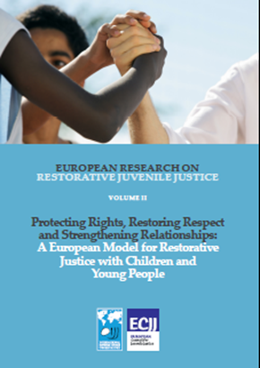
Cultural capital
Rights: UN Convention on the Rights of the Child, Beijing Rules, EU Directive on Victims
Protection and safety
Participation and respect
Ability to speak their truth free from domination

Slide 7
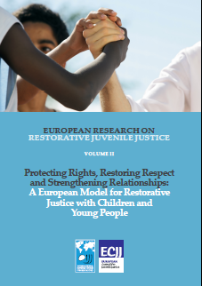
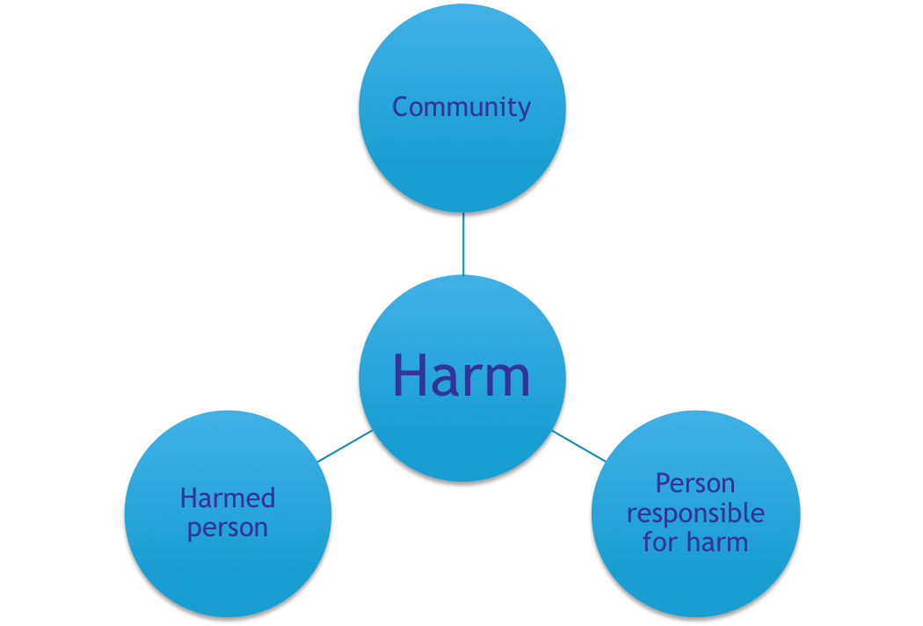
Social capital
Relationships are fundamental in society as well as in restorative processes
The balanced model of restorative justice

Slide 8
Intellectual capital
Those responsible for harm and the community
Those who have been harmed
under-reporting
Specific to the individual: nature of the harm, level of reisience, quality of support
Shattered assumptions of the world and self
Avoid the impulse to rescue (Tali Gal)

Slide 9
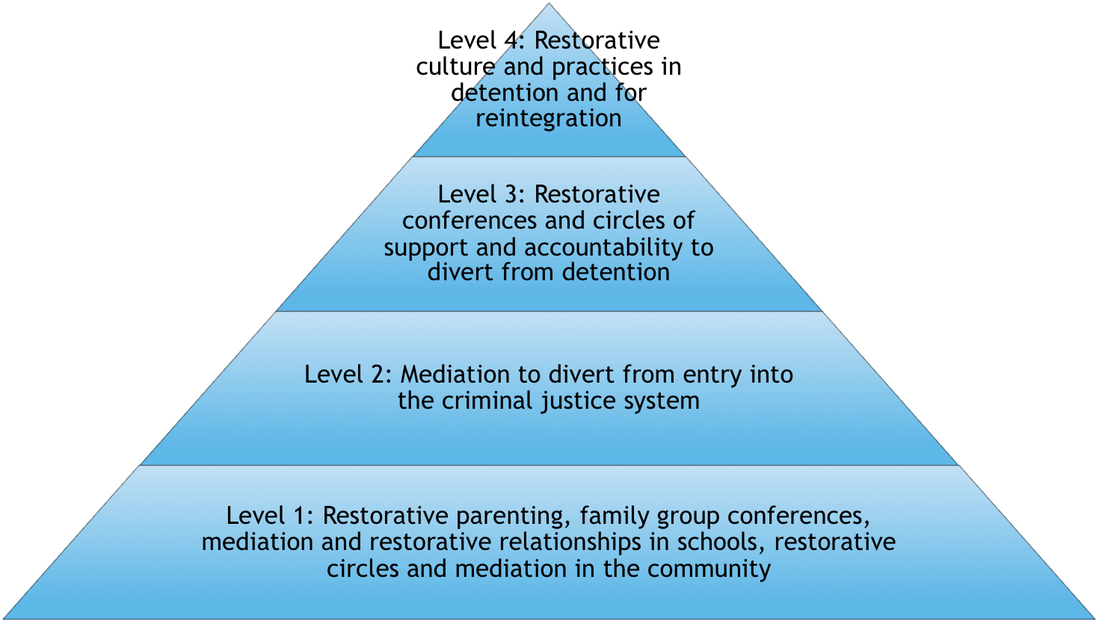
Holistic policy framework
Level 4: To make detention more humane and effective in reintegrating young people
Level 3: To use detention only as a last resort
Level 2: To prevent offending resulting in prosecution
Level 1: To prevent and contain harmful actions involving children and young people within civil society

Slide 10
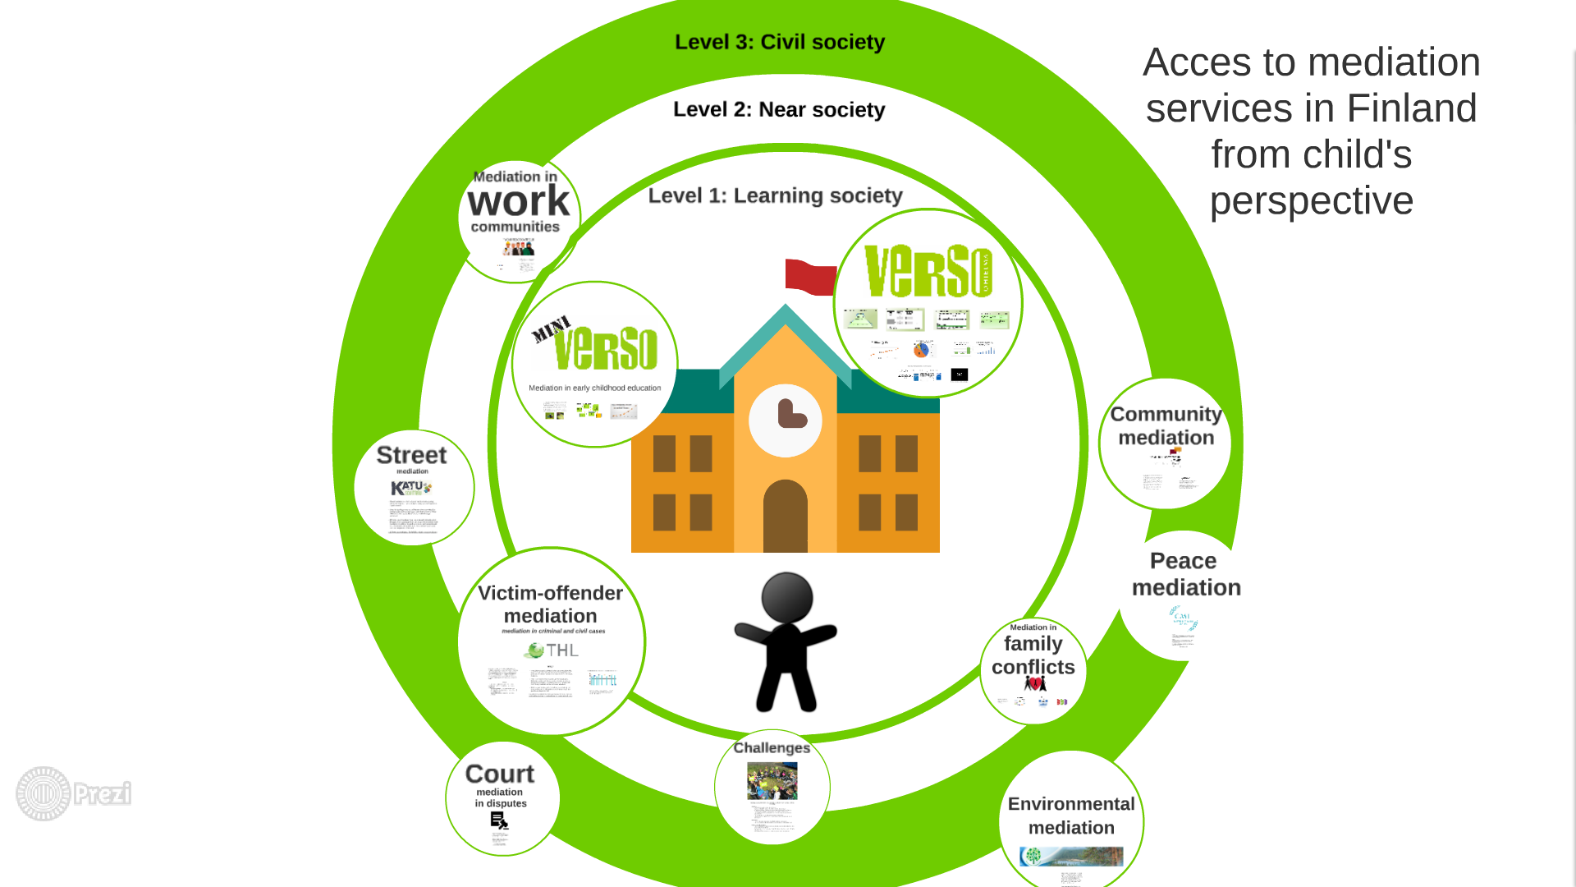
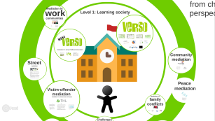

Slide 11
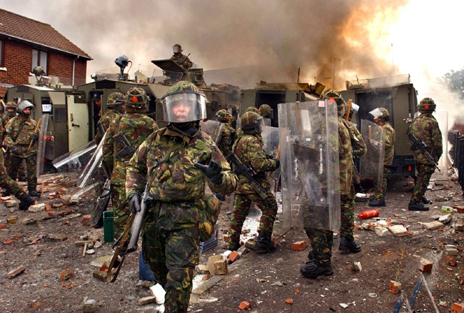
Restorative justice in Northern Ireland: origins

Slide 12
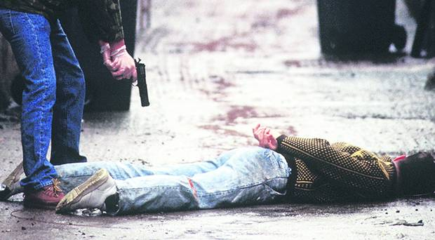
s a parody of policing - not a substitute for it, says Malachi O'Doherty.
11

Slide 13
Northern Ireland and Restorative Justice
Community system
Community restorative justice Ireland
Alternatives NI
CARE and others
School system
Children’s Services
Family Group Conferences
Children’s Units
Criminal Justice System
Pre-sentence
Low risk – Police restorative cautioning
Medium risk – Public Prosecution Service referral for diversionary conference by Youth Conference Service
High risk – Youth Court referrals to Youth Conference Service
Post sentence
Prison Service – desistance and resettlement
Probation Service – Victims Unit

Slide 14
Youth Conferences
Statutory since 2002
Mainstream within the youth justice system
Prosecution referred
Youth court referred
Offenders and victims decide
All offences other than those with a mandatory sentence
Referrals and ratification by PPS or Youth Court

Slide 15
Outcomes for Youth Conferences
Number of youth conferences now over 20,000
Over 100,000 people have participated in a youth conference
Victim attendance; 50/70%
Victim and young person satisfaction ; 90% and 95
26% serious or very serious offences, 53% intermediate, 21% minor
94% successful completion of plans
Reoffending 35.4 % (22% for serious harm)
Reoffending for all other community disposals 53.5%; for custody 68.3%
England and Wales put over twice as many young people into custody as Northern Ireland

Slide 16
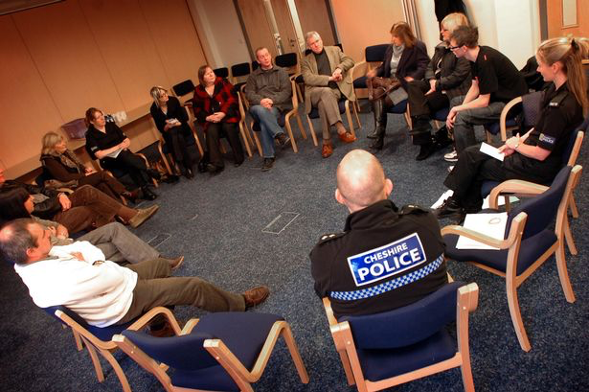
Restorative conference

Slide 17
Restorative conferences
When there is a more serious harm
The victim needs more attention to recover
The perpetrator needs more attention to prevent further acts of harm.
Involves families, supporters, community, professionals.
A process of accountability, storytelling, dialogue and agreement.

